Slide 1



Corona Virus Analysis in SQL
Firas Ben Thayer
Notes:
Hello Mentorness team! Today’s topic of my Corona Virus Analysis in SQL

Slide 2

CONTENTS
Introduction.
Dataset Overview.
Data Exploration.
Key Findings.
Conclusion.

Slide 3
INTRODUCTION
The COVID-19 pandemic has significantly affected public health, necessitating immediate data-driven insights to comprehend the virus's proliferation. In my role as a data analyst, I scrutinized the COVID-19 dataset to extract valuable knowledge and share the results.

Slide 4
DATASET OVERVIEW
PROVINCE: Geographic subdivision within a country/region.
COUNTRY/REGION: Geographic entity where data is recorded.
LATITUDE: North south position on earth surface.
LONGITUDE: East-west position on earth surface.
DATE: Recorded date of corona virus data.
CONFIRMED: Number of diagnosed corona virus cases.
DEATHS: Number of corona virus related deaths.
RECOVERED: Number of recovered corona.

Slide 5
DATA EXPLORATION AND ANALYSIS
Setting up our database.
Analyse data to answer questions.

Slide 6
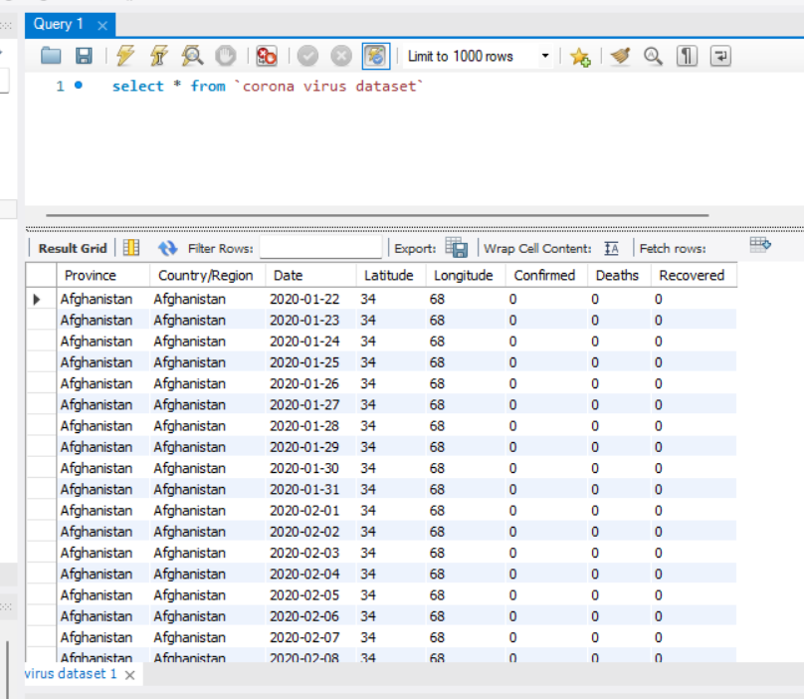
SETTING UP OUR DATABASE

Slide 7
Key Findings
The examination uncovered a swift surge in Covid-19 cases during 2020, reaching a zenith in the early part of 2021. Following the initiation of vaccinations, the mortality rate started to level off, and significant enhancements in recovery rates were observed. These improvements can be credited to the implementation of improved treatment procedures and the effective response of healthcare systems.

Slide 8
Conclusion
In the future, the emphasis of research should be on assessing the enduring effectiveness of vaccines and their effects on virus variations. It's crucial to ensure that our strategies are flexible and can adapt to the changing dynamics of the pandemic.

